Slide 2
Bioinformatics
Faster, better, stronger

Slide 3
De stof komt uit de college presentaties en Jonathan Pevsner "Bioinformatics and Functional Genomics"
(Wiley Blackwell; 3e editie) en een aantal extra papers
(deze worden niet expliciet in de betrokken colleges genoemd, en zijn te vinden onder "achtergrond").
Lecture | Topic | Chapter | Pages | Comments
1 | Bioinformatics | 1 | Helemaal
2 | Access to seq data | 2 | Helemaal | Niet "Command line access"
3 | Sequence Alignment | 3 | 70-103 | Niet box 3.5, box 3.7, box 3.8
4 | BLAST | 4 | 121-134, 138-143, 145-159 | Niet fig.4.14, box 4.1, p.143 E- en p-values
5 | Database searching | 5 | 171-177 | Niet box 5.1
6 | Next Generation Sequencing | 9 | 377-384

Slide 4
Presentation content
Chapter 1

Slide 5
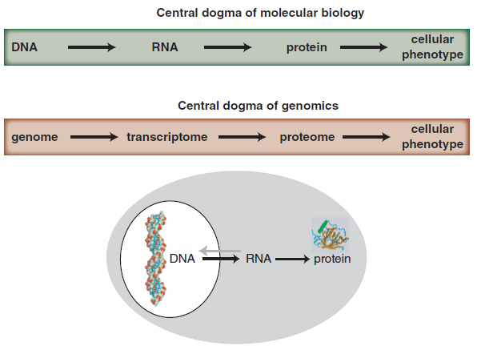
Central dogma of molecular biology & genomics
B&FG 3e
Fig. 1-1
Page 4

Slide 6
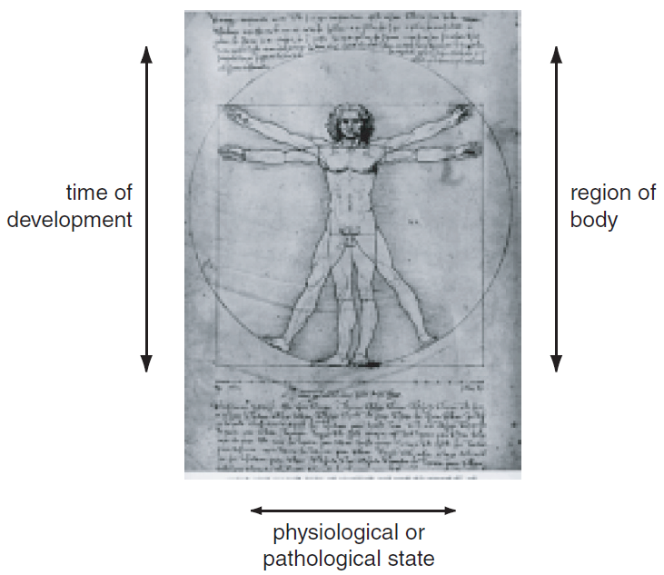
Growth of DNA sequence in repositories
B&FG 3e
Fig. 1-2
Page 6

Slide 7
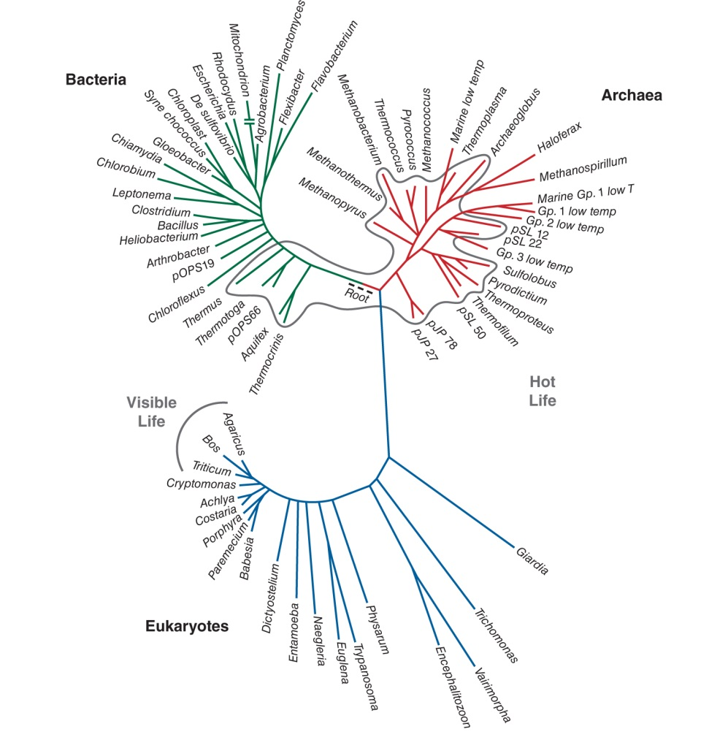
Three domains of life: bacteria, archaea, eukaryotes
B&FG 3e
Fig. 1-3
Page 7

Slide 8
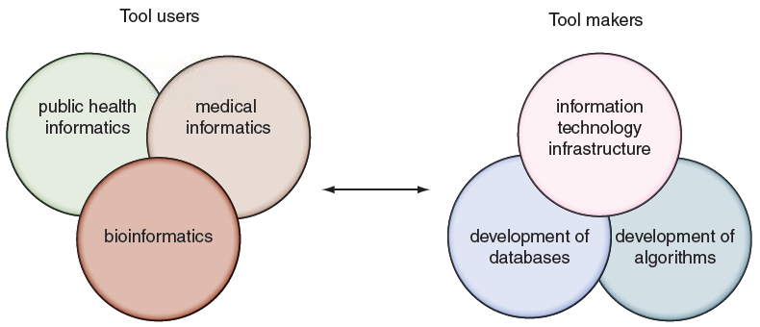
Tool makers and tool users across informatics disciplines
Many informatics disciplines have emerged in recent years. Bioinformatics is distinguished by its particular focus on DNA and proteins (impacting its databases, its tools, and its entire culture).
B&FG 3e
Fig. 1.6
Page 15

Slide 9
Presentation content
Chapter 3

Slide 10
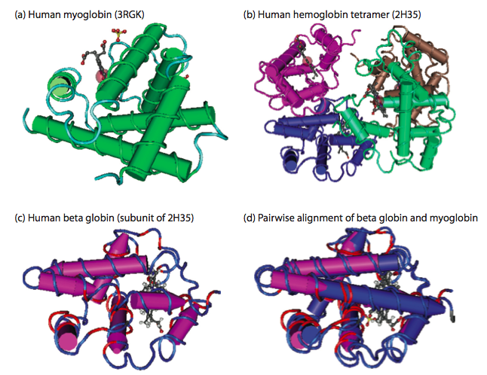
Globin homologs
myoglobin
hemoglobin
B&FG 3e
Fig. 3.1
Page 71
beta globin
beta globin and myoglobin (aligned)

Slide 11
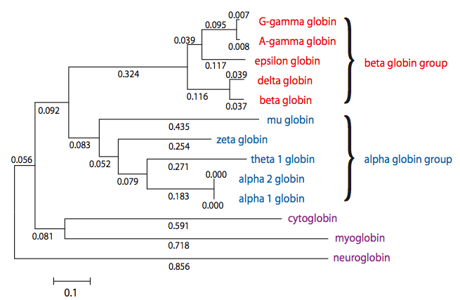
Paralogs: members of a gene (protein) family within a
species. This tree shows human globin paralogs.
B&FG 3e
Fig. 3.3
Page 73

Slide 12
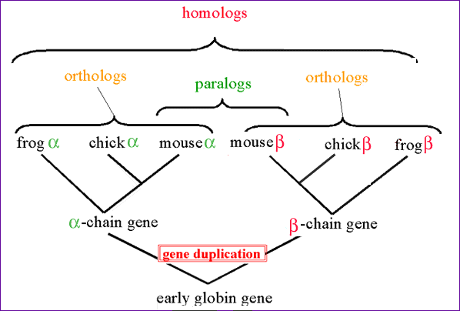
Orthologs and paralogs are often viewed in a single tree
Source: NCBI

Slide 13
Gaps
• Positions at which a letter is paired with a null
are called gaps.
• Gap scores are typically negative.
• Since a single mutational event may cause the insertion
or deletion of more than one residue, the presence of
a gap is ascribed more significance than the
length of the gap. Thus there are separate penalties for
gap creation and gap extension.
• In BLAST, it is rarely necessary to change gap values
from the default.

Slide 14
The 7 steps of Dayhoff
Accept Point Mutations (PAM)
Frequency of amino acids
Relative Mutability of amino acids
Mutation probability matrix for the evolutionary distance of 1 PAM
PAM250 and other PAM matrices
From a mutation probability matrix to a relatedness odds matrix
Log-odds scoring matrix

Slide 15
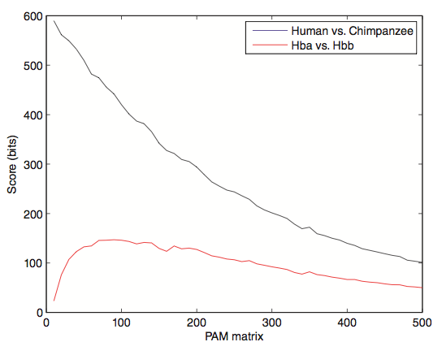
Effect of scoring matrix on bit scores
Look at score for distantly related proteins (e.g. beta globin versus alpha globin) and note that PAM10 or similar matrices assign very low scores. This effect is not seen for very closely related proteins (e.g. a chimp vs. human globin).
B&FG 3e
Fig. 3-16
Page 92

Slide 16
BLOSUM Matrices
BLOSUM matrices are based on local alignments.
All BLOSUM matrices are based on observed alignments;
they are not extrapolated from comparisons of
closely related proteins.
BLOSUM stands for blocks substitution matrix.
BLOSUM62 is a matrix calculated from comparisons of
sequences with no less than 62% divergence.
BLOSUM62 is the default matrix in BLAST 2.0.
Notes:
16

Slide 17
BLOSUM Matrices
100
collapse
100
100
collapse
62
62
62
collapse
Percent amino acid identity
30
30
30
BLOSUM80
BLOSUM62
BLOSUM30
Notes:
17

Slide 18
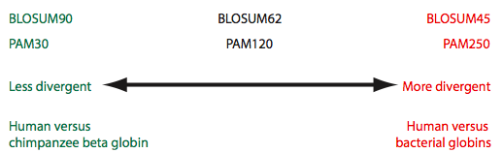
Summary of PAM and BLOSUM matrices
A higher PAM number, and a lower BLOSUM number, tends to correspond to a matrix tuned to more divergent proteins.
B&FG 3e
Fig. 3-18
Page 94

Slide 19
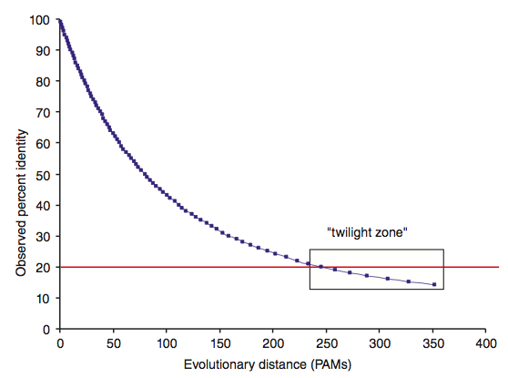
Two randomly diverging protein sequences change
in a negatively exponential fashion
B&FG 3e
Fig. 3-19
Page 95

Slide 20
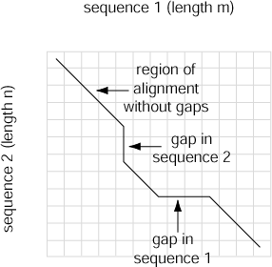
Four possible outcomes in aligning two sequences
[1] identity (stay along a diagonal)
[2] mismatch (stay along a diagonal)
[3] gap in one sequence (move vertically!)
[4] gap in the other sequence (move horizontally!)
B&FG 3e
Fig. 3-20
Page 97
Notes:
20

Slide 21
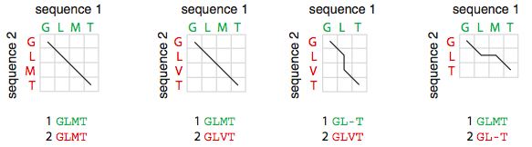
Four possible outcomes in aligning two sequences
B&FG 3e
Fig. 3-20
Page 97

Slide 22
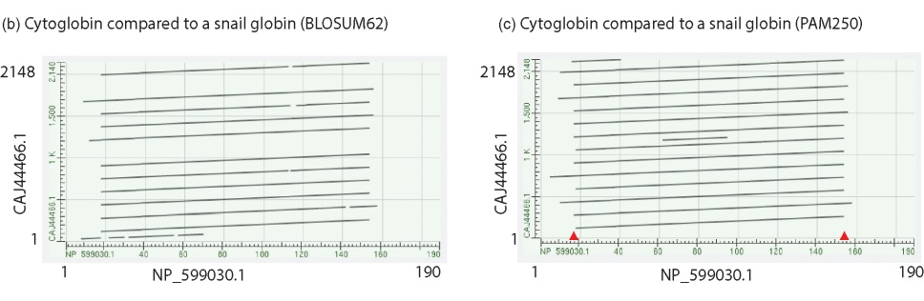
Pairwise alignment with dotplots
Search human cytoglobin against a large snail globin (having many globin repeats). More repeats are observed using PAM250 than BLOSUM62.
To “read” this plot note that cytoglobin (x-axis) matches the snail globin (y-axis) at about a dozen locations across the snail protein. Red arrows indicate that the first few and last few amino acids of cytoglobin do not participate in this repeat structure.
B&FG 3e
Fig. 3-25
Page 105

Slide 23
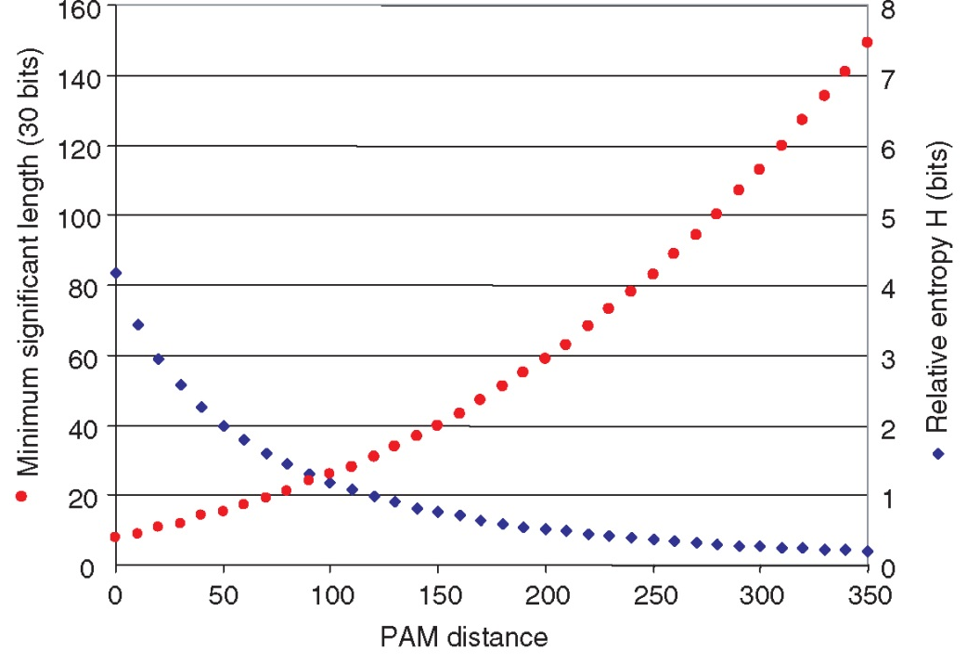
Relative entropy (H) as a function of PAM distance
For PAM matrices with low values (e.g. PAM10) the relative entropy (in bits) is high and the minimum alignment length needed to detect a significant pairwise alighment is short. Relative entropy relates to the information content.
For PAM250 and similar matrices the relative entropy is low. It is necessary to have a longer region of amino acids aligned (e.g. 80 residues) to detect significant pairwise relatedness.
B&FG 3e
Fig. 3-27
Page 109

Slide 24
Presentation content
Chapter 4: pg. 121-134, 138-143, 145-159

Slide 25
Why use BLAST?
BLAST searching is fundamental to understanding
the relatedness of any favorite query sequence
to other known proteins or DNA sequences.
Applications include
identifying orthologs and paralogs
discovering new genes or proteins
discovering variants of genes or proteins
investigating expressed sequence tags (ESTs)
exploring protein structure and function

Slide 26
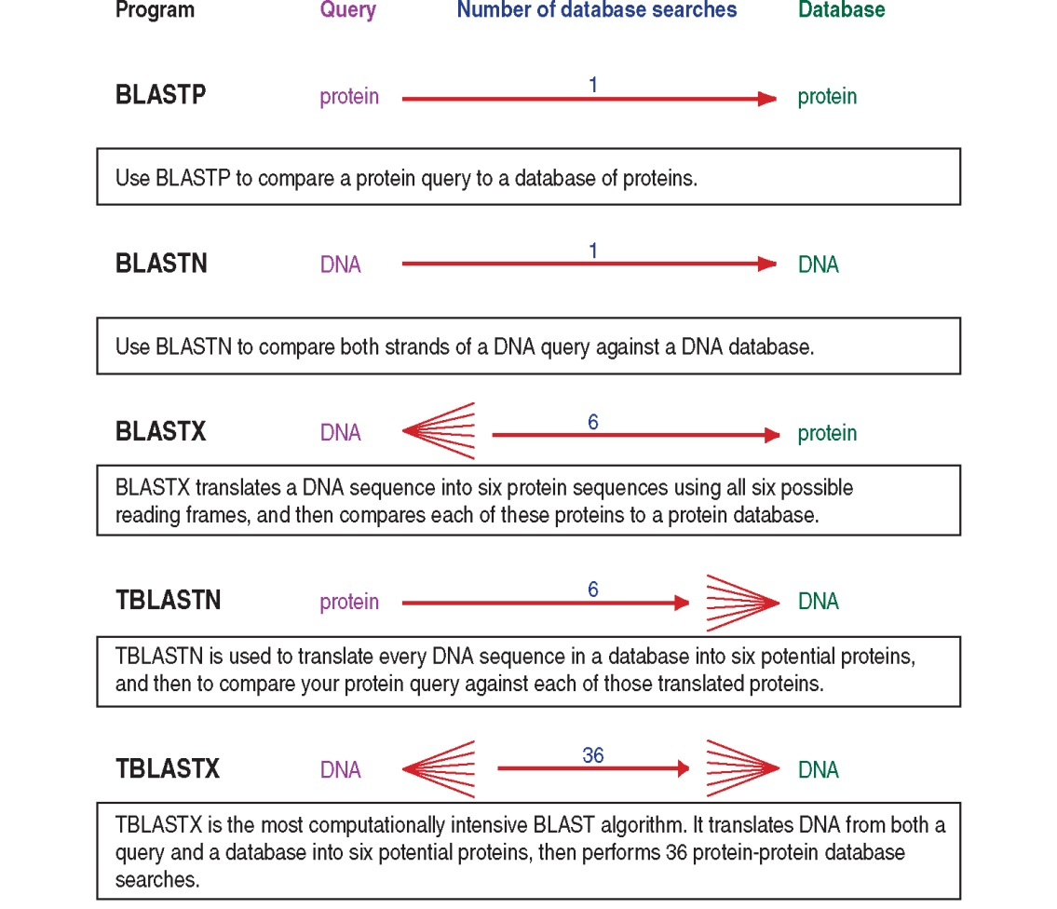
BLAST step 2: choose program
B&FG 3e
Fig. 4-2
Page 124

Slide 27
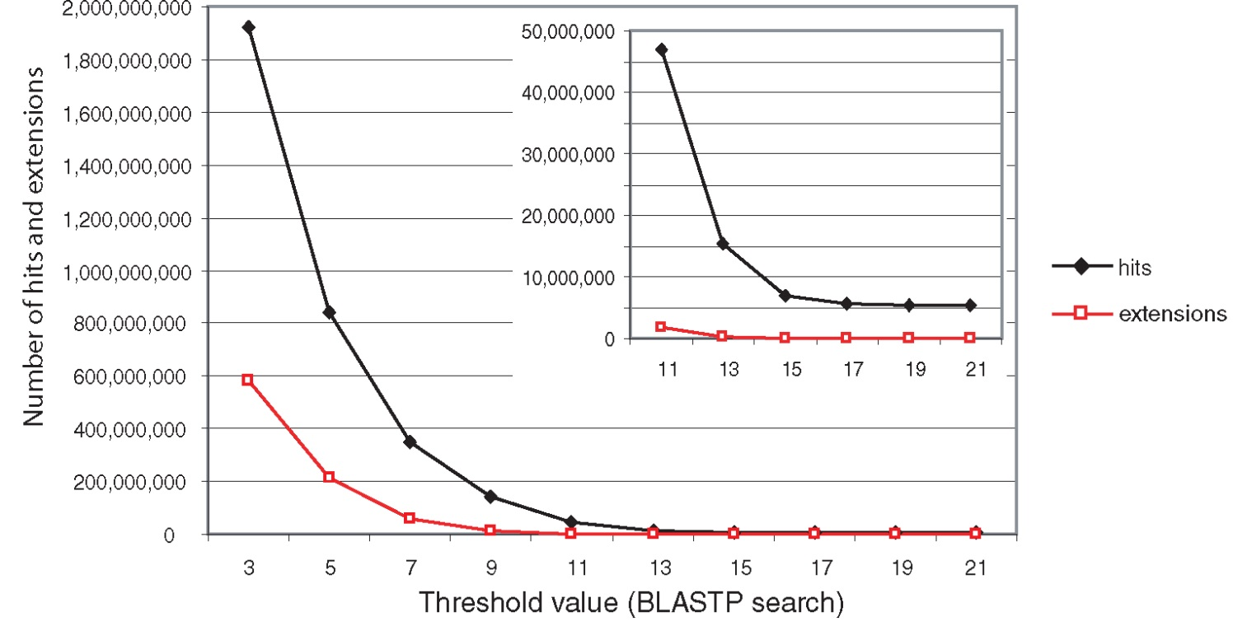
Effect of changing the threshold T: Lower T yields more database hits (black line) and extensions (red)
B&FG 3e
Fig. 4-13
Page 140

Slide 28
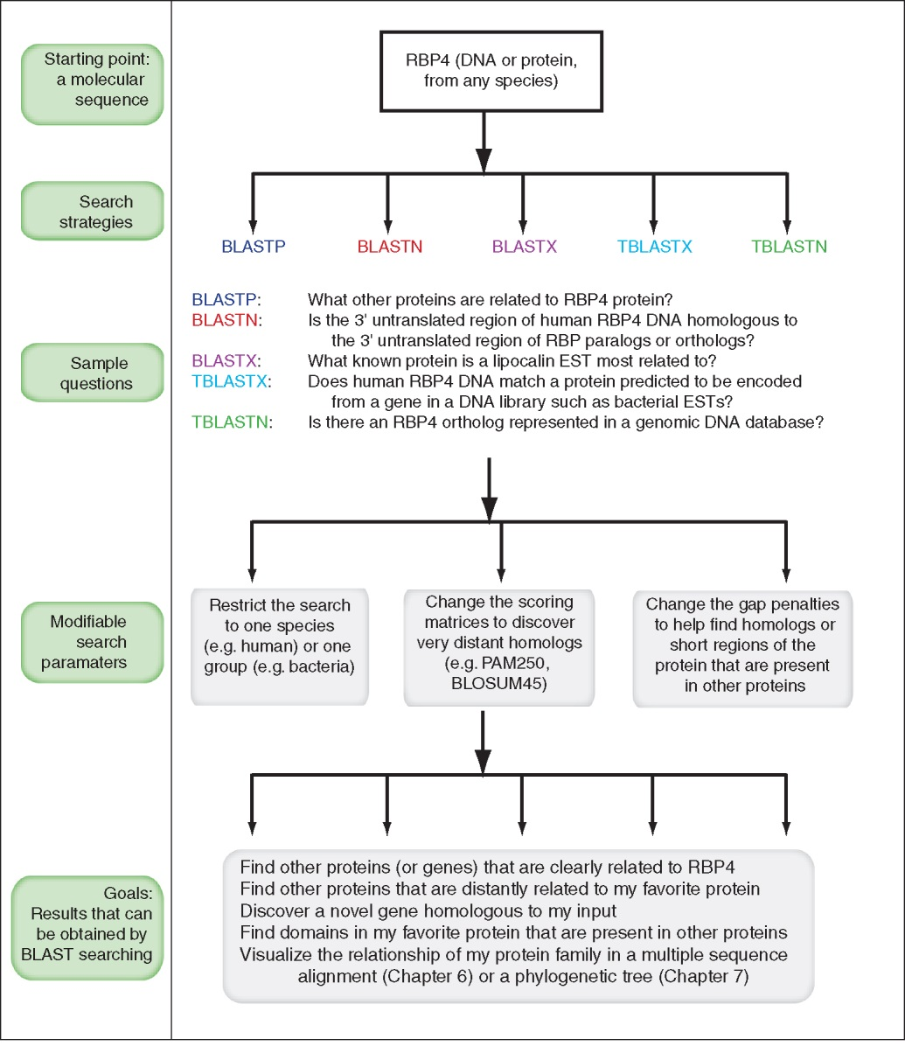
Overview of BLAST search strategies
B&FG 3e
Fig. 4-15
Page 145

Slide 29
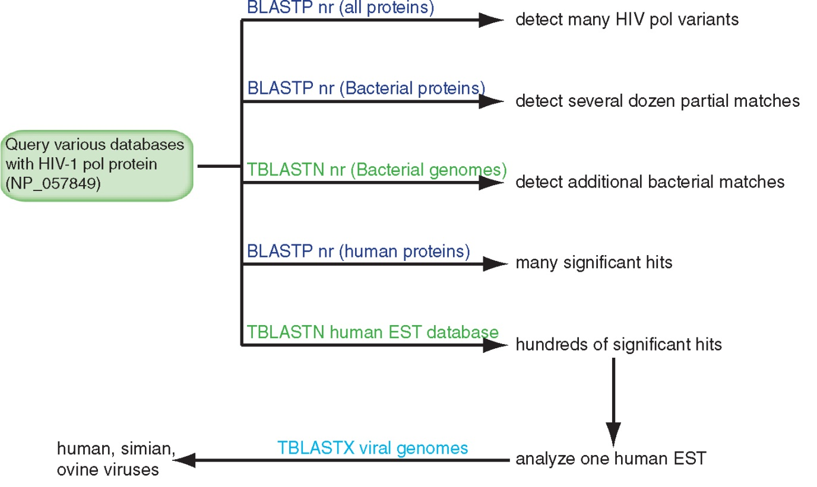
BLAST searching a multidomain protein: HIV-1 pol
B&FG 3e
Fig. 4-18
Page 151

Slide 30
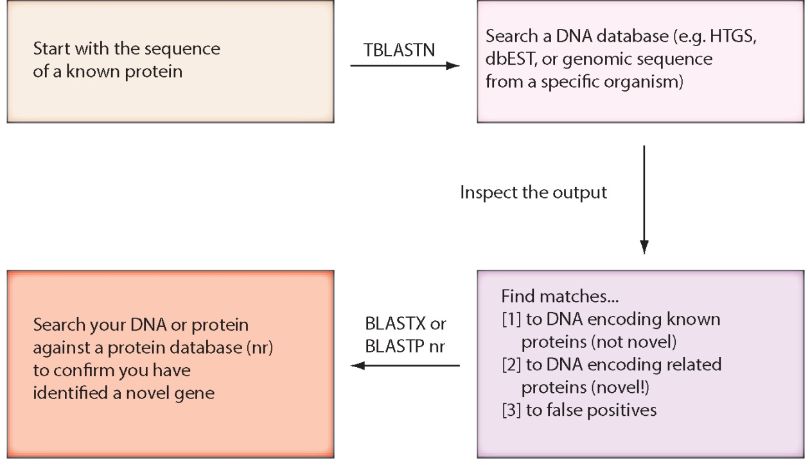
“Find-a-gene project” to practice BLAST
Start with the sequence of a known protein
TBLASTN
Inspect the output
BLASTX nr
or
BLASTP nr
B&FG 3e
Fig. 4-23
Page 157

Slide 31
PSI-BLAST is performed in five steps
[1] Select a query and search it against a protein database
[2] PSI-BLAST constructs a multiple sequence alignment
then creates a “profile” or specialized position-specific
scoring matrix (PSSM)
B&FG 3e
Page 172

Slide 32
A R N D C Q E G H I L K M F P S T W Y V
1 M -1 -2 -2 -3 -2 -1 -2 -3 -2 1 2 -2 6 0 -3 -2 -1 -2 -1 1
2 K -1 1 0 1 -4 2 4 -2 0 -3 -3 3 -2 -4 -1 0 -1 -3 -2 -3
3 W -3 -3 -4 -5 -3 -2 -3 -3 -3 -3 -2 -3 -2 1 -4 -3 -3 12 2 -3
4 V 0 -3 -3 -4 -1 -3 -3 -4 -4 3 1 -3 1 -1 -3 -2 0 -3 -1 4
5 W -3 -3 -4 -5 -3 -2 -3 -3 -3 -3 -2 -3 -2 1 -4 -3 -3 12 2 -3
6 A 5 -2 -2 -2 -1 -1 -1 0 -2 -2 -2 -1 -1 -3 -1 1 0 -3 -2 0
7 L -2 -2 -4 -4 -1 -2 -3 -4 -3 2 4 -3 2 0 -3 -3 -1 -2 -1 1
8 L -1 -3 -3 -4 -1 -3 -3 -4 -3 2 2 -3 1 3 -3 -2 -1 -2 0 3
9 L -1 -3 -4 -4 -1 -2 -3 -4 -3 2 4 -3 2 0 -3 -3 -1 -2 -1 2
10 L -2 -2 -4 -4 -1 -2 -3 -4 -3 2 4 -3 2 0 -3 -3 -1 -2 -1 1
11 A 5 -2 -2 -2 -1 -1 -1 0 -2 -2 -2 -1 -1 -3 -1 1 0 -3 -2 0
12 A 5 -2 -2 -2 -1 -1 -1 0 -2 -2 -2 -1 -1 -3 -1 1 0 -3 -2 0
13 W -2 -3 -4 -4 -2 -2 -3 -4 -3 1 4 -3 2 1 -3 -3 -2 7 0 0
14 A 3 -2 -1 -2 -1 -1 -2 4 -2 -2 -2 -1 -2 -3 -1 1 -1 -3 -3 -1
15 A 2 -1 0 -1 -2 2 0 2 -1 -3 -3 0 -2 -3 -1 3 0 -3 -2 -2
16 A 4 -2 -1 -2 -1 -1 -1 3 -2 -2 -2 -1 -1 -3 -1 1 0 -3 -2 -1
...
37 S 2 -1 0 -1 -1 0 0 0 -1 -2 -3 0 -2 -3 -1 4 1 -3 -2 -2
38 G 0 -3 -1 -2 -3 -2 -2 6 -2 -4 -4 -2 -3 -4 -2 0 -2 -3 -3 -4
39 T 0 -1 0 -1 -1 -1 -1 -2 -2 -1 -1 -1 -1 -2 -1 1 5 -3 -2 0
40 W -3 -3 -4 -5 -3 -2 -3 -3 -3 -3 -2 -3 -2 1 -4 -3 -3 12 2 -3
41 Y -2 -2 -2 -3 -3 -2 -2 -3 2 -2 -1 -2 -1 3 -3 -2 -2 2 7 -1
42 A 4 -2 -2 -2 -1 -1 -1 0 -2 -2 -2 -1 -1 -3 -1 1 0 -3 -2 0
20 amino acids
all the amino acids from position 1 to the end of your PSI-BLAST query protein

Slide 33
A R N D C Q E G H I L K M F P S T W Y V
1 M -1 -2 -2 -3 -2 -1 -2 -3 -2 1 2 -2 6 0 -3 -2 -1 -2 -1 1
2 K -1 1 0 1 -4 2 4 -2 0 -3 -3 3 -2 -4 -1 0 -1 -3 -2 -3
3 W -3 -3 -4 -5 -3 -2 -3 -3 -3 -3 -2 -3 -2 1 -4 -3 -3 12 2 -3
4 V 0 -3 -3 -4 -1 -3 -3 -4 -4 3 1 -3 1 -1 -3 -2 0 -3 -1 4
5 W -3 -3 -4 -5 -3 -2 -3 -3 -3 -3 -2 -3 -2 1 -4 -3 -3 12 2 -3
6 A 5 -2 -2 -2 -1 -1 -1 0 -2 -2 -2 -1 -1 -3 -1 1 0 -3 -2 0
7 L -2 -2 -4 -4 -1 -2 -3 -4 -3 2 4 -3 2 0 -3 -3 -1 -2 -1 1
8 L -1 -3 -3 -4 -1 -3 -3 -4 -3 2 2 -3 1 3 -3 -2 -1 -2 0 3
9 L -1 -3 -4 -4 -1 -2 -3 -4 -3 2 4 -3 2 0 -3 -3 -1 -2 -1 2
10 L -2 -2 -4 -4 -1 -2 -3 -4 -3 2 4 -3 2 0 -3 -3 -1 -2 -1 1
11 A 5 -2 -2 -2 -1 -1 -1 0 -2 -2 -2 -1 -1 -3 -1 1 0 -3 -2 0
12 A 5 -2 -2 -2 -1 -1 -1 0 -2 -2 -2 -1 -1 -3 -1 1 0 -3 -2 0
13 W -2 -3 -4 -4 -2 -2 -3 -4 -3 1 4 -3 2 1 -3 -3 -2 7 0 0
14 A 3 -2 -1 -2 -1 -1 -2 4 -2 -2 -2 -1 -2 -3 -1 1 -1 -3 -3 -1
15 A 2 -1 0 -1 -2 2 0 2 -1 -3 -3 0 -2 -3 -1 3 0 -3 -2 -2
16 A 4 -2 -1 -2 -1 -1 -1 3 -2 -2 -2 -1 -1 -3 -1 1 0 -3 -2 -1
...
37 S 2 -1 0 -1 -1 0 0 0 -1 -2 -3 0 -2 -3 -1 4 1 -3 -2 -2
38 G 0 -3 -1 -2 -3 -2 -2 6 -2 -4 -4 -2 -3 -4 -2 0 -2 -3 -3 -4
39 T 0 -1 0 -1 -1 -1 -1 -2 -2 -1 -1 -1 -1 -2 -1 1 5 -3 -2 0
40 W -3 -3 -4 -5 -3 -2 -3 -3 -3 -3 -2 -3 -2 1 -4 -3 -3 12 2 -3
41 Y -2 -2 -2 -3 -3 -2 -2 -3 2 -2 -1 -2 -1 3 -3 -2 -2 2 7 -1
42 A 4 -2 -2 -2 -1 -1 -1 0 -2 -2 -2 -1 -1 -3 -1 1 0 -3 -2 0
note that a given amino acid (such as alanine) in your query protein can receive different scores for matching alanine—depending on the position in the protein

Slide 34
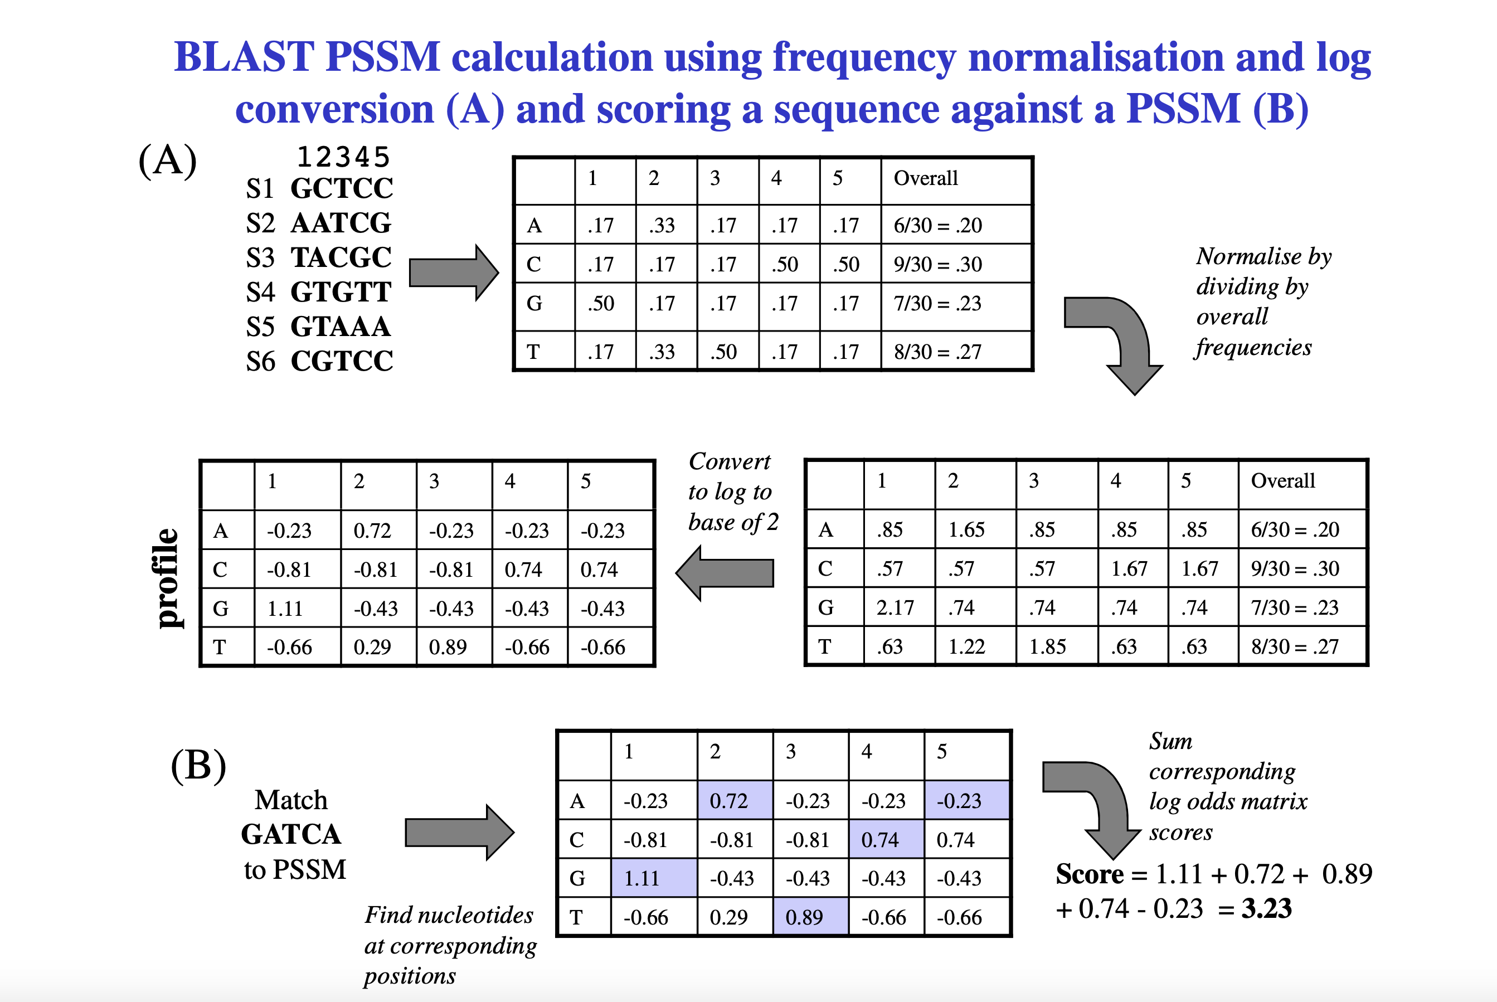

Slide 35
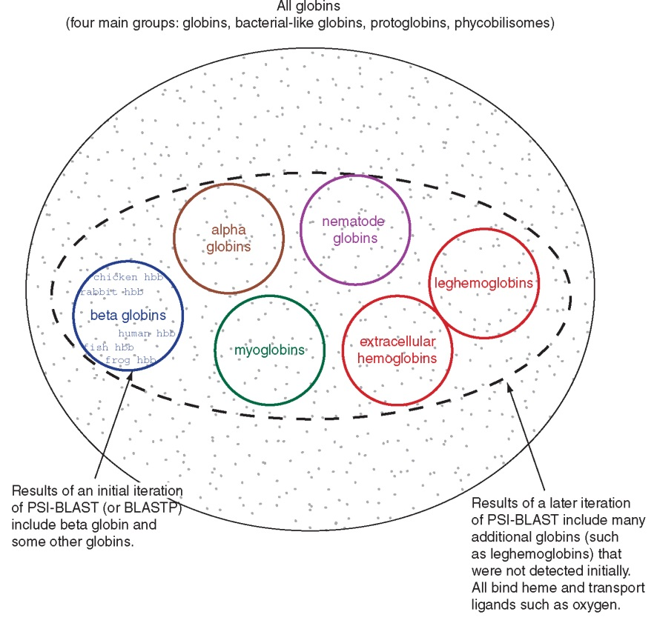
PSI‐BLAST algorithm increases the sensitivity of a database search by detecting homologous matches with relatively low sequence identity
B&FG 3e
Fig. 5.5
Page 176

Slide 36
Presentation content
Chapter 9: pg. 377 - 384

Slide 37
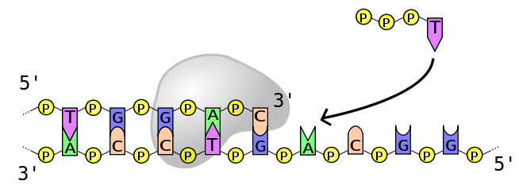
Sequencing by synthesis
These are the ingredients of many sequencing technologies
dNTPs
DNA polymerase
Primer
ssDNA template

Slide 38
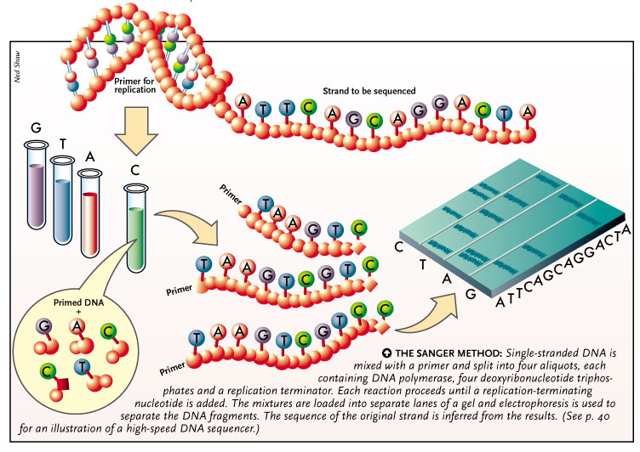

Slide 39
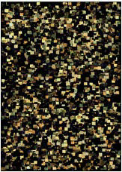
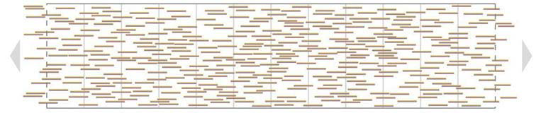
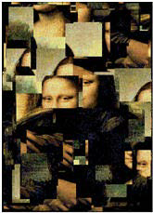
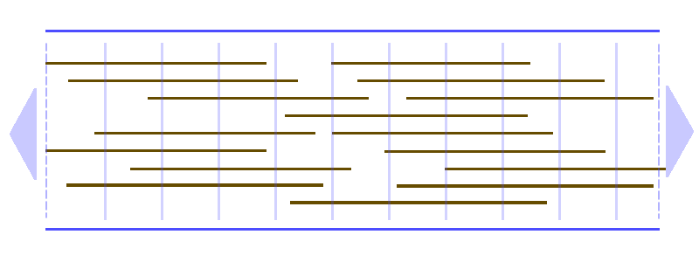
The read length race
Why are longer reads so desirable?

Slide 40
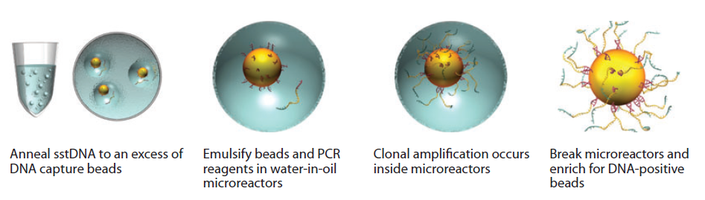
454 (Roche), SOLiD and Ion Torrent use Emulsion PCR for amplification

Slide 41
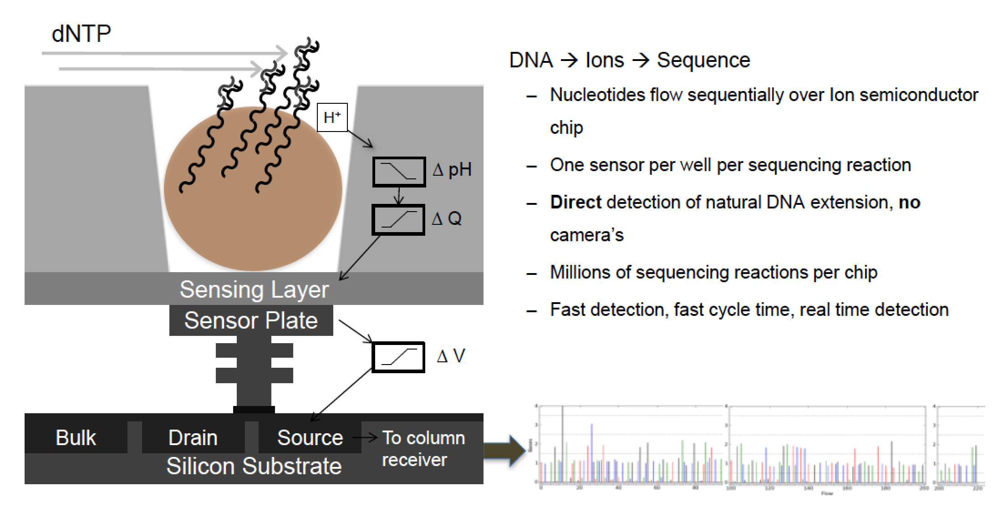
Ion Torrent sequencing
movie

Slide 42
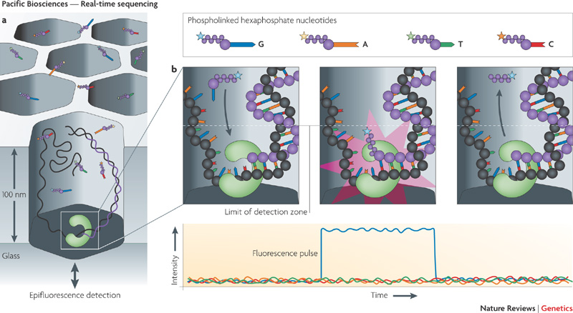
Single molecule sequencers - PacBio
2-3 kb single continuous read!
High (>10%) error rate!
movie

Slide 43
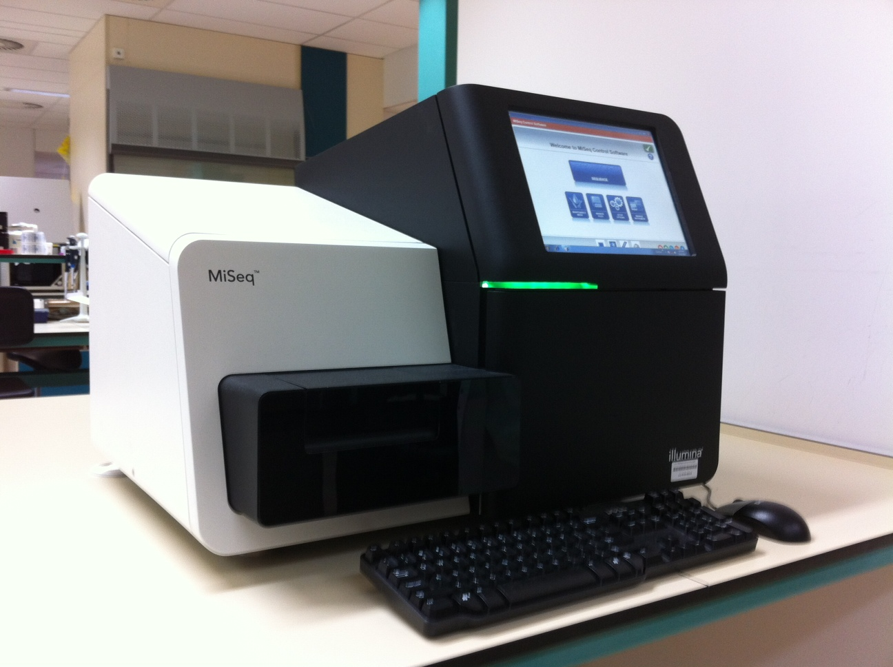

The Illumina platform
umcg/genetics

Slide 44
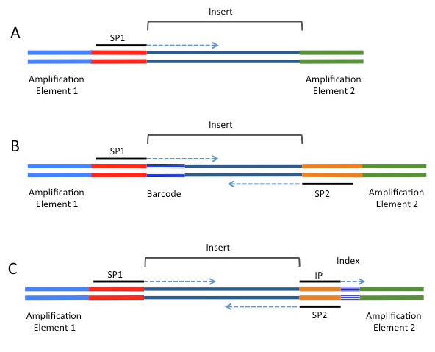
Adapters up close
Elements that can be included in NGS adapters on the Illumina platform.
SP1=primary sequencing primer; SP2=paired-end primer; IP=sequencing primer for the index read.
(A) Minimal adapter components. (B) Barcode configuration supporting a paired-end read. (C) Index configuration supporting a paired-end read.
Index’s can be used for upfront de-multiplexing
http://rnaseq.uoregon.edu

Slide 45
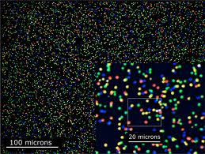
From image to sequence (2)
Practice:
Dust specks
Proximity
Low signal
Noise
Degradation during cycles

Slide 46
Presentation content
Chapter 9: pg. 377 - 384

Slide 47
Human genome sequencing
We currently obtain whole genome sequences at 30x to 50x depth of coverage. For a typical individual:
2.8 billion base pairs are sequenced
~3-4 million single nucleotide variants
~600,000 insertions/deletions (SNPs)
Cost (research basis) is <$2000
We try to sequence mother/father/child trios
We also can enrich the collection of exons (“whole exome sequencing”). For a typical individual:
60 million base pairs are sequenced
There are ~80,000 variants
There are ~11,000 nonsynonymous SNPs

Slide 48
Whole genome sequencing (WGS) costs
have declined dramatically
B&FG 3e
Fig.9-3
Page 383

Slide 49
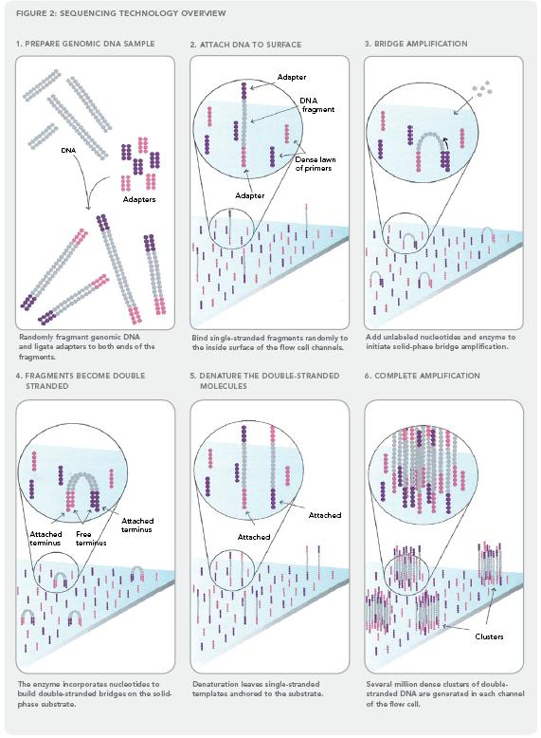
Illumina sequencing technology in 12 steps
Source: http://www.illumina.com/downloads/SS_DNAsequencing.pdf
Notes:
49

Slide 50
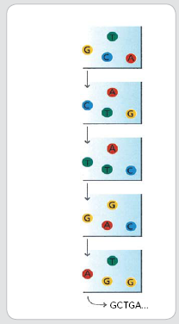
7. Determine first base
8. Image first base
9. Determine second base
10. Image second chemistry cycle
11. Sequencing over multiple chemistry cycles
12. Align data
The sequencing cycles are repeated to determine the sequence of bases in a fragment, one base at a time.

Slide 51
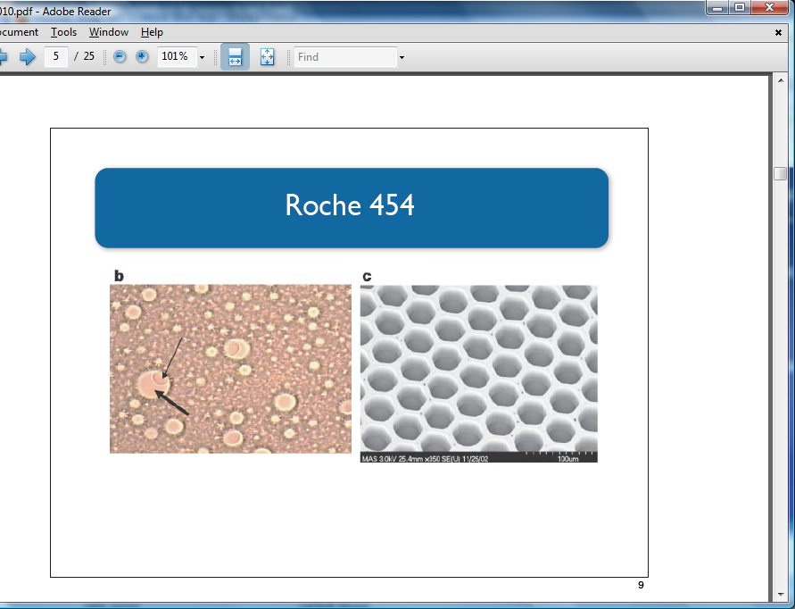
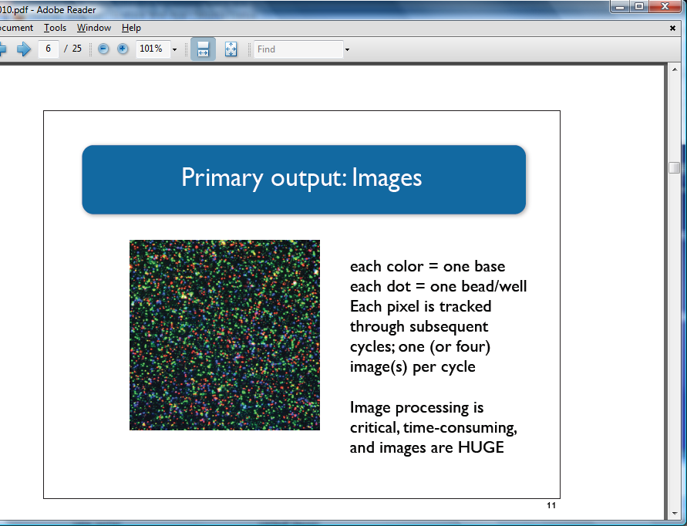
NGS technologies: Roche 454
Introduced in 2005 (sequenced Mycoplasma genitalium genome in one run)
~2400 publications (as of Jan. 2013) but now defunct
Sequencing by synthesis: nucleotide incorporation leads to light emission
Notes:
51

